Slide 1
Inflatable Life Jacket Maintenance and Rearming
Chuck Hawley

Slide 2
What would you do if someone asked you to drive an unfamiliar car?
Adjust the seat position?
Put on the seatbelt?
Adjust the mirrors?
Check the gas?
Ask if it’s insured?
See if it’s a stick shift?

Slide 3
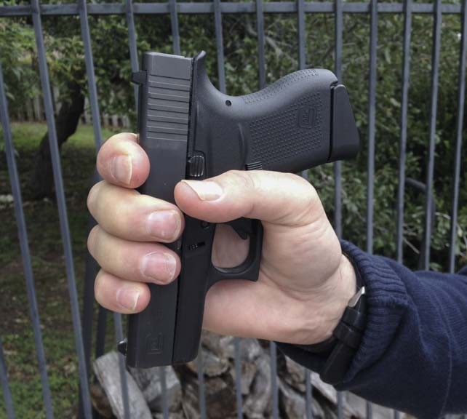
What would you do if someone handed you a firearm?
Make sure they are handing it to you in a safe way?
Point away from people and living things?
Put on the safety?
Drop the magazine out, or open the cylinder?
Treat it with the utmost respect?

Slide 4
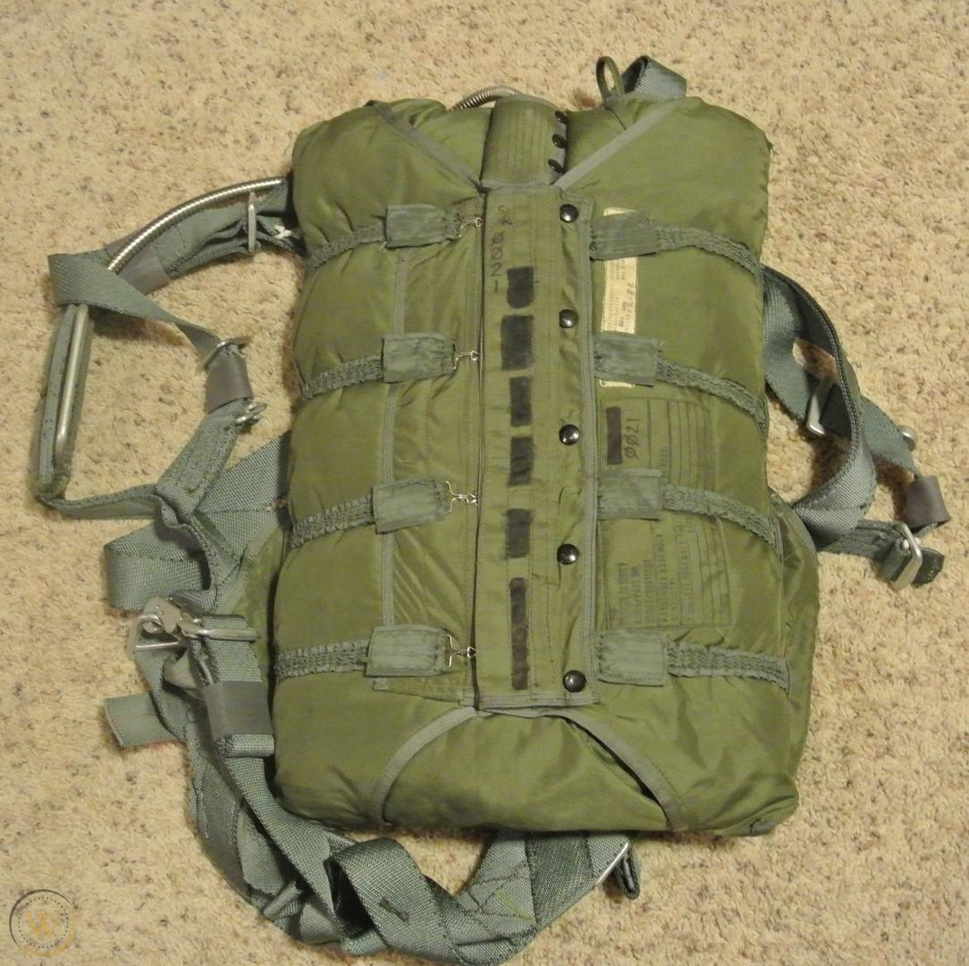
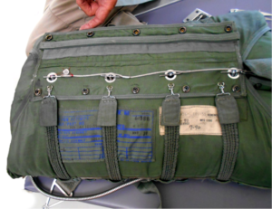
What would you do if someone offered you a parachute?
Ask who packed it?
Check to see if the pins are bent?
Identify where the ripcord is?
Tighten the leg straps?

Slide 5
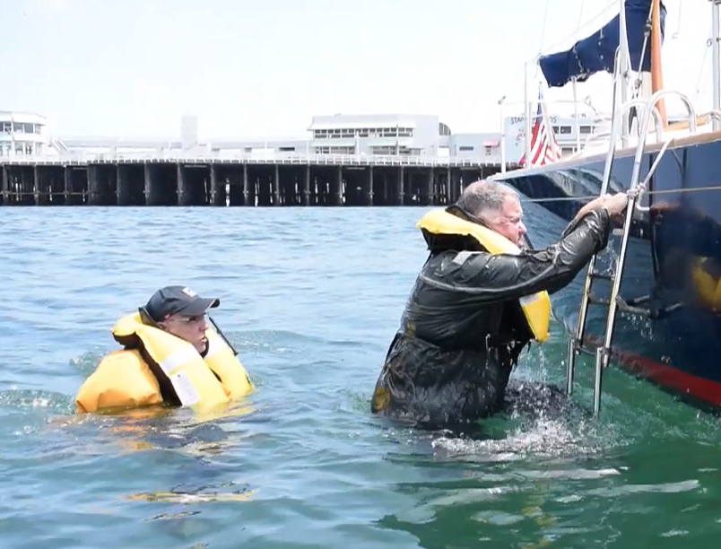
Why don’t we have a similar procedure when we are given an inflatable life jacket?
Is it ready to inflate?
Does it fit?
Do I understand its operation?
Is it manual or water-activated?
Where’s the inflation lanyard?
Where’s the oral inflation tube?

Slide 6
Bottom Line First
Never assume an inflatable life jacket is “ready to go” unless you have verified its readiness
If you borrow a life jacket, take a minute to understand its operation and readiness
Understand the two or three methods that an inflatable life jacket uses to inflate and provide buoyancy
Know where the oral inflation tube is located
(It’s on the opposite side from the inflator.)
Know how to verify that your life jacket can hold air
If you remember nothing else, remember the following key points about inflatable life jacket maintenance

Slide 7
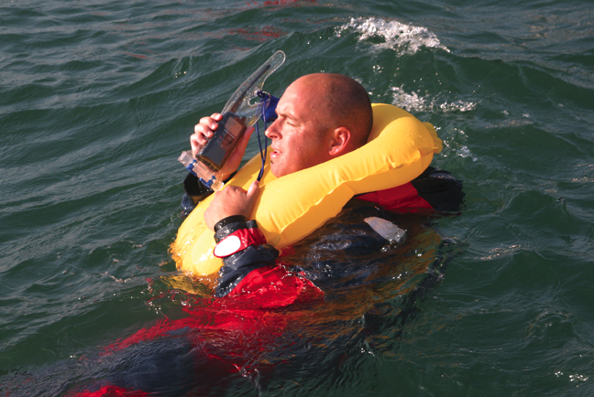
Why wear a life jacket?
Life jackets provide buoyancy and allow you to maintain an airway until you can be rescued after accidental immersion.
Greater buoyancy can keep your mouth out of the water in rough conditions, avoiding “mouth immersions”.
Inflatables combine freedom of movement on deck, with excellent in-water performance.

Slide 8
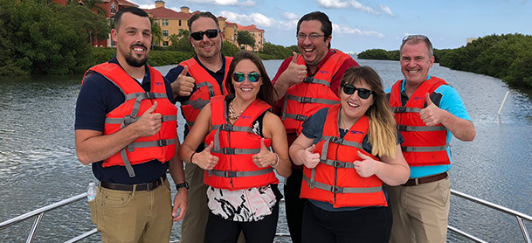
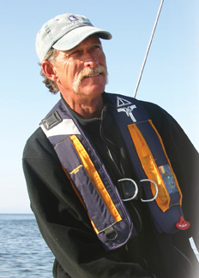
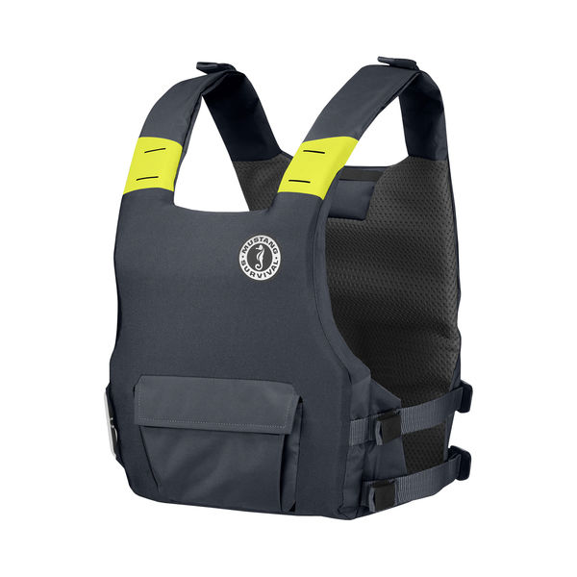
Two Three basic kinds of life jackets
Inherently buoyant (foam)
Hybrid (foam and gas)
Inflatable (gas)

Slide 9
If you find yourself in the water...
If life jacket has not inflated, pull ripcord
If life jacket has still not inflated, expose oral inflation tube and blow
Verify that all PIW have fully-deployed life jackets (no Velcro binds)
Turn on any strobe lights or MOB beacons
Conserve heat
HELP posture or huddle if three or more
Close closures on FWG
Don’t swim for help
Use whistle to attract attention
Splash to make yourself a larger target for aerial searchers

Slide 10
Types of Inflatables
Amount of buoyancy
16, 24, 35, 60# of buoyancy
Hybrid with 7# foam + 15# inflatable
Type of inflator
Manual, water-activated, or hydrostatic
Style
Stole or vest Vs. belt pack
Integral harness (sailing) or no harness (everyone else)?
Type of closure
Velcro or burstable zipper
Mandatory wear or not?
Understand the various styles of inflatable life jackets so you can select the one that is best for your use.

Slide 11
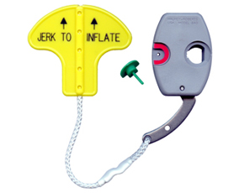
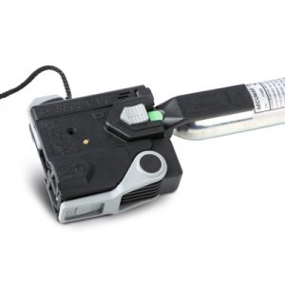
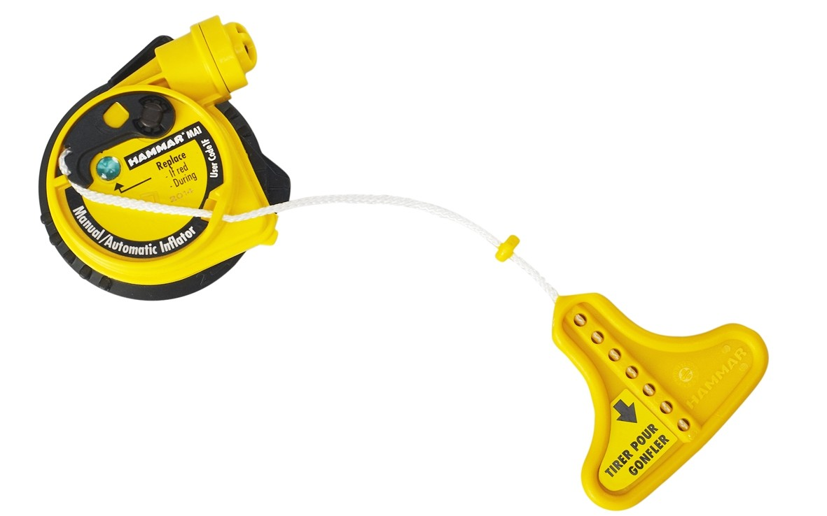
Manual, water activated, or hydrostatic?
Largely left up to the wearer or PIC
Issue with manual-only is cold-shock and the gasp reflex. May not allow user to pull the “ripcord” (lanyard)
Issue with water-activated is a risk of inflation when not intended
Hydrostatic models are resistant to splashes and humidity, but must be immersed 4” to activate.
Manual Inflator
Water-activated Inflator
Hydrostatic Inflator

Slide 12
Two different standards organizations
Underwriter’s Laboratories, UL
Uses a Standards Technical Panel to work on new performance and manufacturing standards for future life jackets. Generally required for US approved life jackets. Standards include UL1123, UL1180, etc.
International Standards Organization, ISO
Creates standards using expert standards-makers. Not involved with manufacturing compliance. Standards include 12401 (harnesses) and 12402 (life jackets)

Slide 13
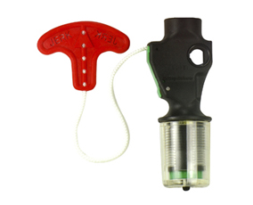
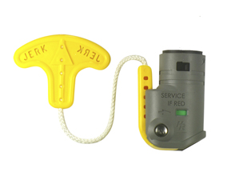
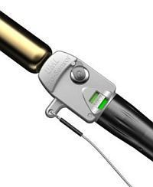
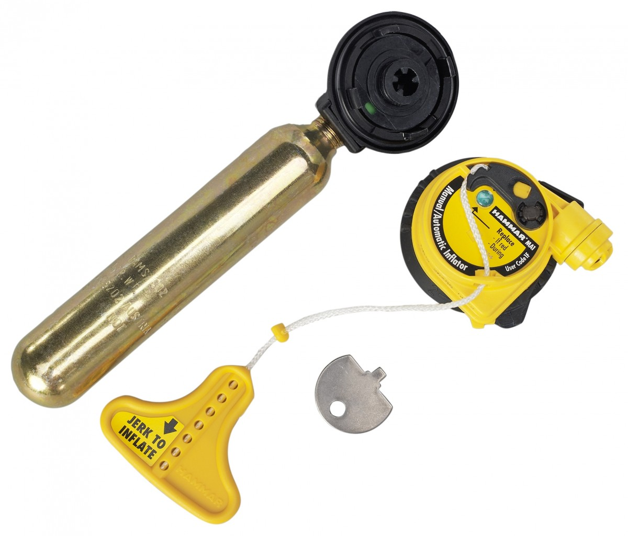
UL and Coast Guard Inflator Designations
6F Older style with no cylinder seal indication.
3F Manual activation with cylinder seal indication
2F Manual with water-backup, cylinder seal indicator, two indicators
1F Manual with water-backup, cylinder seal indicator, one indicator
6F
3F
2F
1F

Slide 14
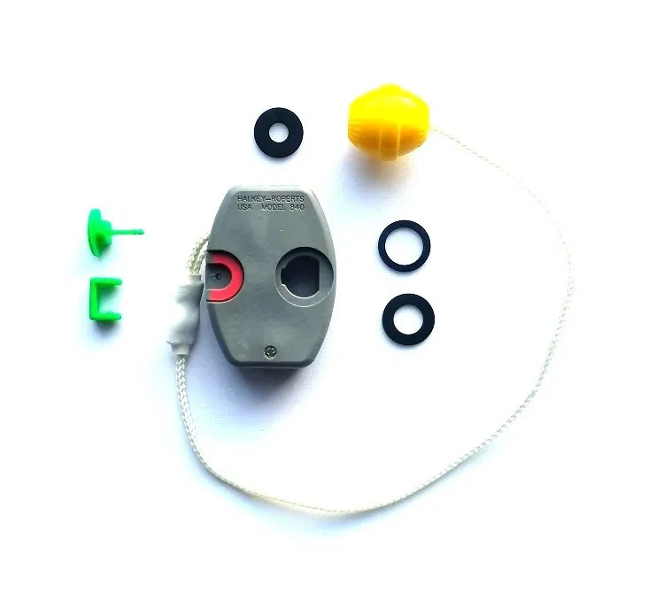
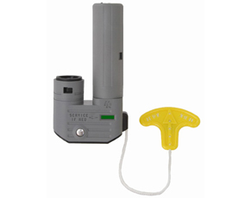
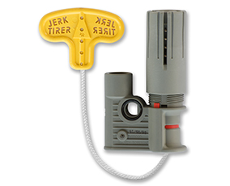
Halkey Roberts Inflators
Most common in the U.S.; found on Mustang, West Marine, Stearns, Onyx and other life jackets
Available in all configurations
Uses a “bobbin” with the manufacturing date inkjetted on it.
Three year “shelf life”
Three year “service life”
Replace all red bobbins ASAP.
Common Manual Inflator

Slide 15
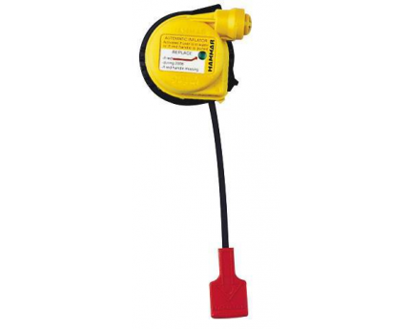
Hammar Inflators
Hydrostatic, meaning that they require water pressure to expose the water-sensing element.
Highly tolerant of splashes and humidity
Highly intolerant of internal pressure in the bladder and shallow (<4”) immersion
5 year replacement interval, $70-$110.

Slide 16
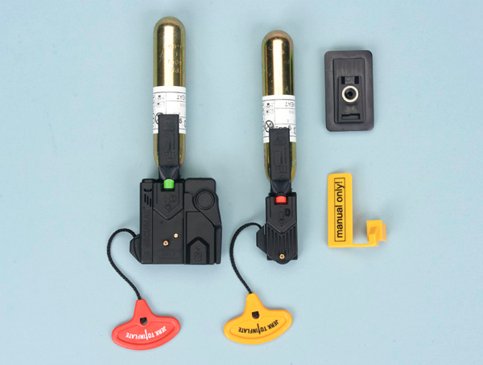
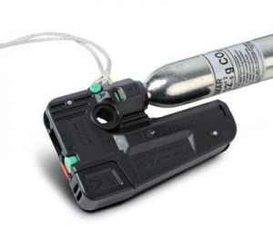
Secumar Inflators
Found on Stearns and West Marine life jackets
Available in all configurations
Water causes a “pill” to disintegrate
Manual Only flag converter
Bayonet-style cylinder requires 90 degree twist

Slide 17
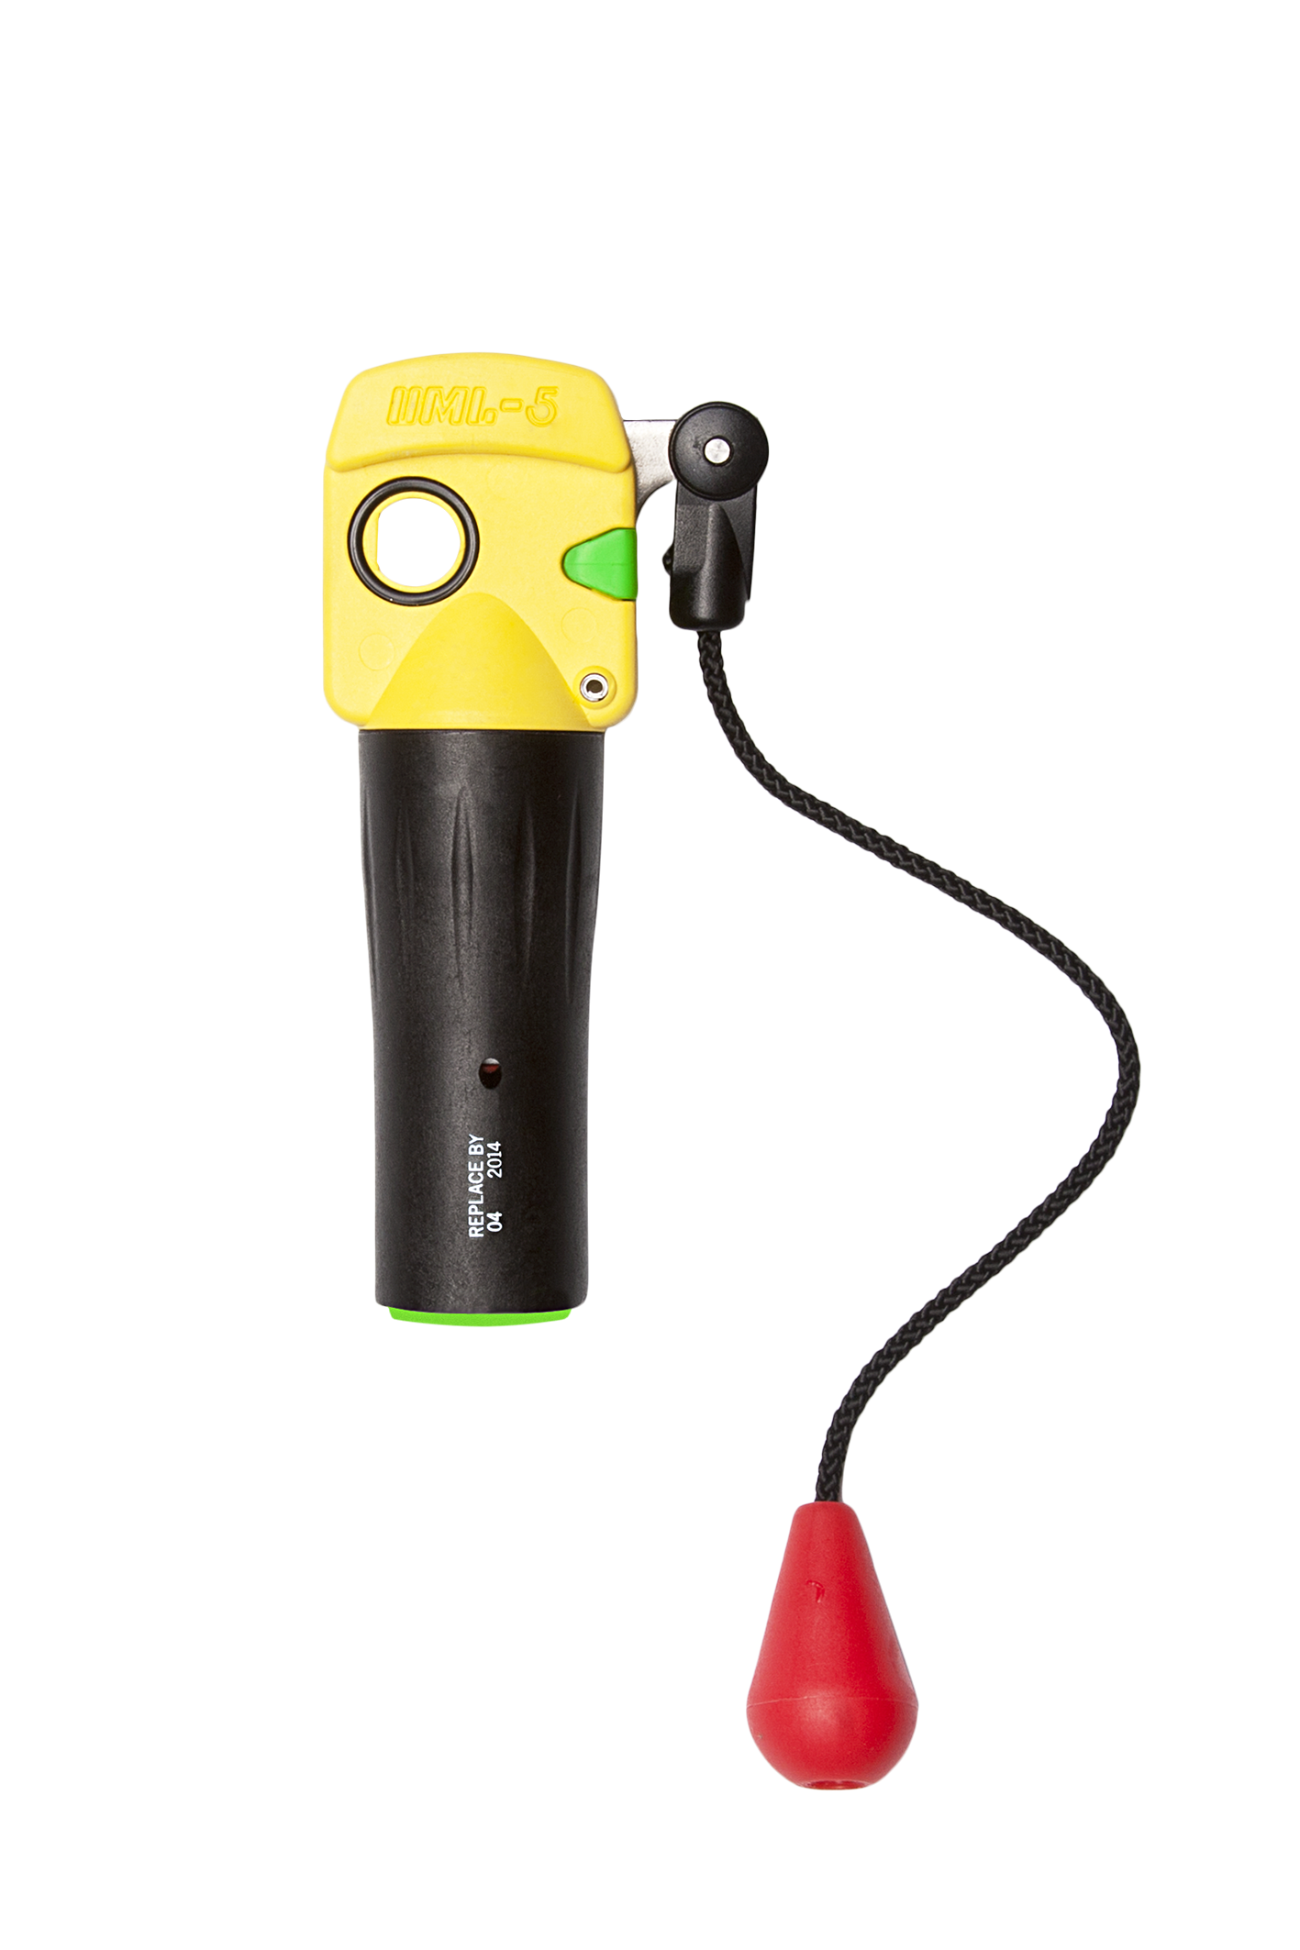
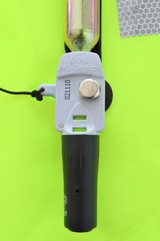
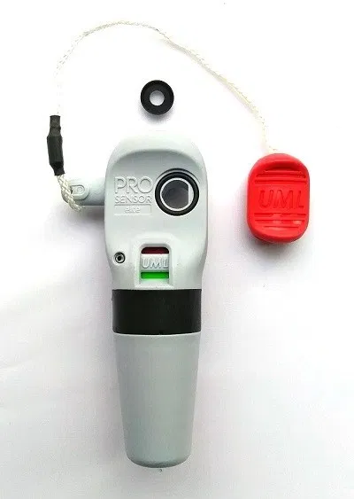
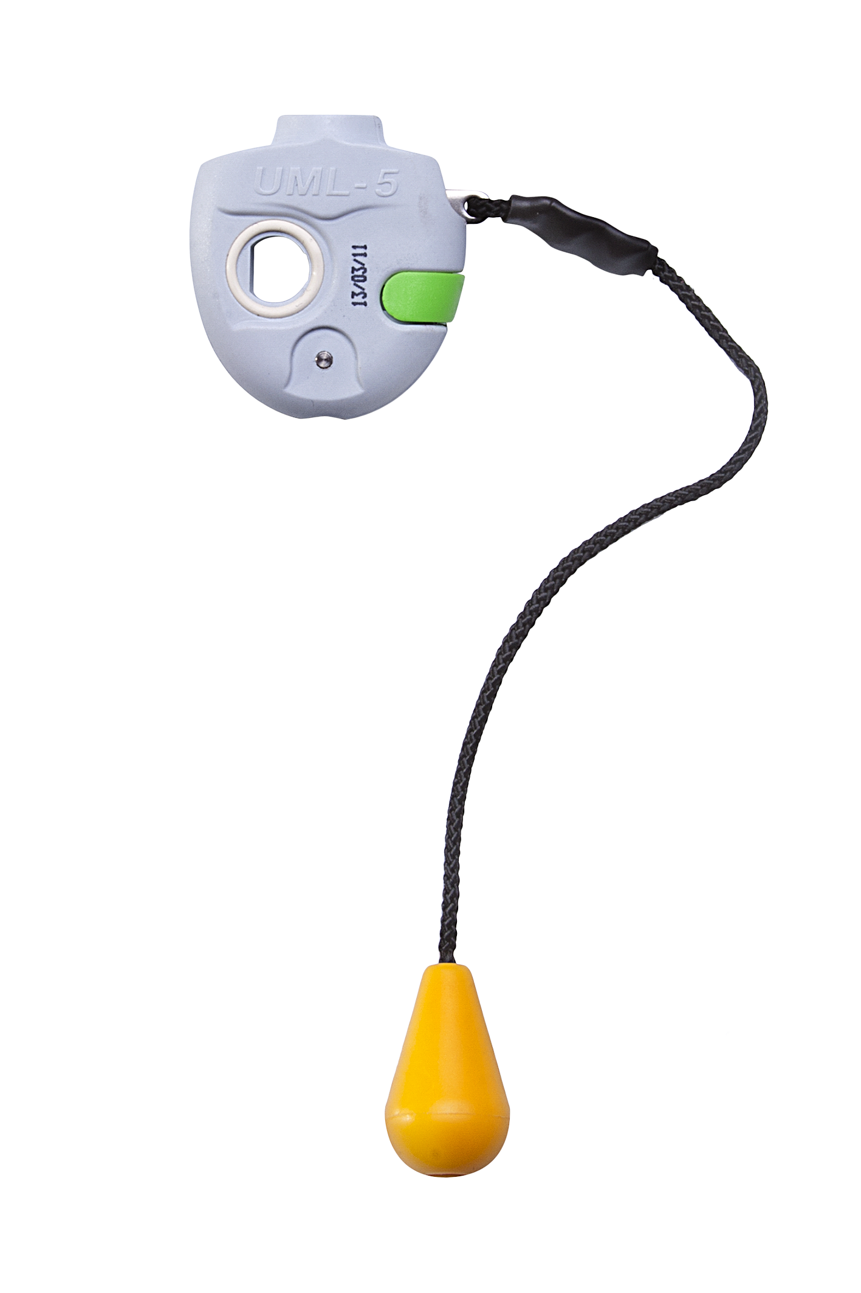
United Moulders Ltd
UK company that makes inflators for ISO approved life jackets.
Compressed paper element for water sensor; turns to mush when wet
Commonly found on Spinlock Crewvest as an option to the Hammar Hydrostatic Inflator.
Pro Sensor
Pro Sensor Elite
Mk 2
Mk 5

Slide 18
Regular inspection, then say “good-bye”!
Every time the life jacket is used
Verify that the CO2 cylinder is full and installed
Verify that the water-sensing element is installed (when applicable)
Periodically (depends on manufacturer, but 2-12 months)
Verify air-holding, accessory operation, replacement of dated items
Repack and note maintenance in logbook
When is it time to say “good-bye”?
Generally, 10 years, or possibly longer if life jacket is in excellent condition

Slide 19
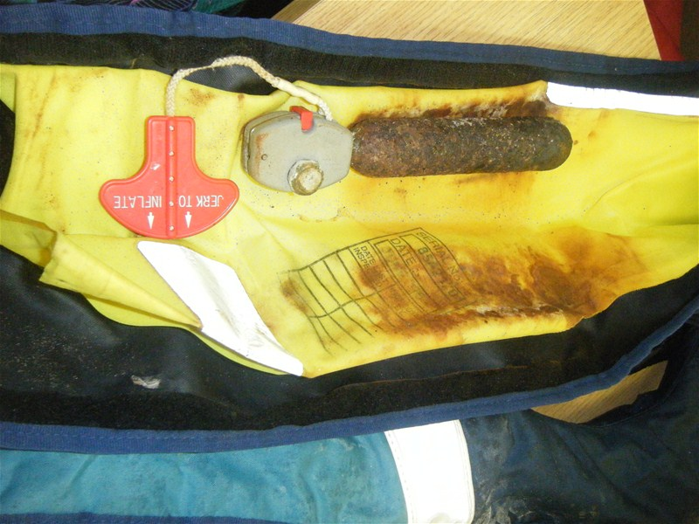
When is a CO2 cylinder replaced?
If it’s been pierced in the small end of the cylinder
If it’s excessively corroded
If it’s part of an assembly with a replacement date (Hammar)

Slide 20
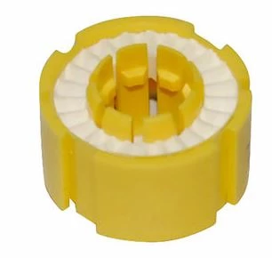
When is the water sensing element replaced?
When it’s been used and has disintegrated
When it’s past its date code (MFR or Replace By?)
When it shows signs of damage

Slide 21
Daily Inspection
Depends on the type of inflator
1F, 2F, or 3F inflator: check for green indicator showing in window.
6F or other inflator: open shroud and check cylinder and w.s.e.*
All: verify fit, condition, appropriateness
*Water Sensing Element

Slide 22
Periodic (annual) inspection
Basic Process (water activated instructions in parens)
Open shroud (cover)
Remove CO2 cylinder
(Remove water sensing element)
Orally or mechanically inflate until firm
Leave for several hours
If you detect an air leak, assume it’s the o.i.t.
Use soap bubble or spit to determine if it’s leaking
Press valve to try to resolve leak
If not o.i.t., immerse vest in water to find leak
If fabric or seam leaks, return to manufacturer or condemn
(Verify date and condition of water sensing element)
Replace if necessary
Verify CO2 cylinder is rust-free and not previously used
Verify operation of all accessories (lights, MOB devices)
Deflate completely
(Re-install water sensing element)
Re-install CO2 cylinder
Refold according to MFR instructions
Varies by manufacturer
Read the instructions
Log your actions
Cylinders last a long time
Water sensing elements are cheap and do deteriorate

Slide 23
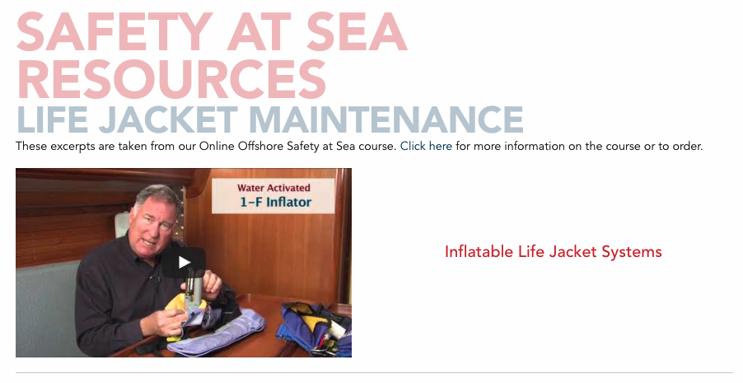
Videos can be found at US Sailing
Search: US Sailing Life Jacket Maintenance

